Slide 1
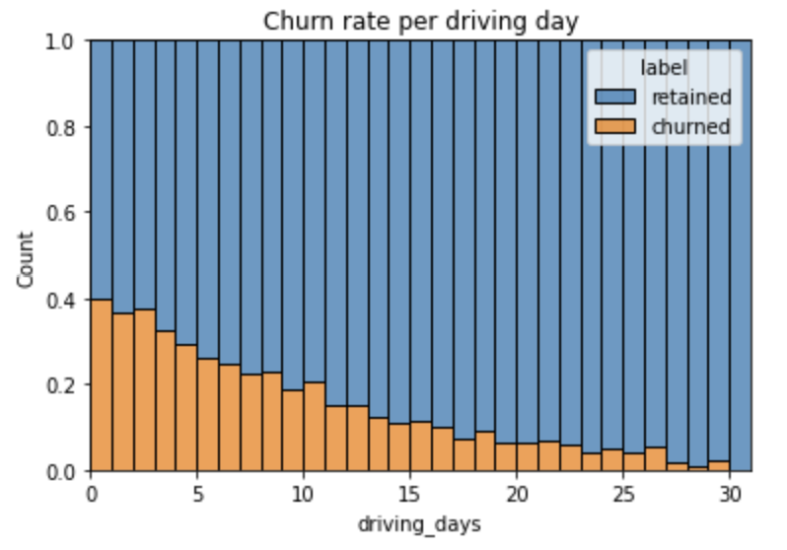
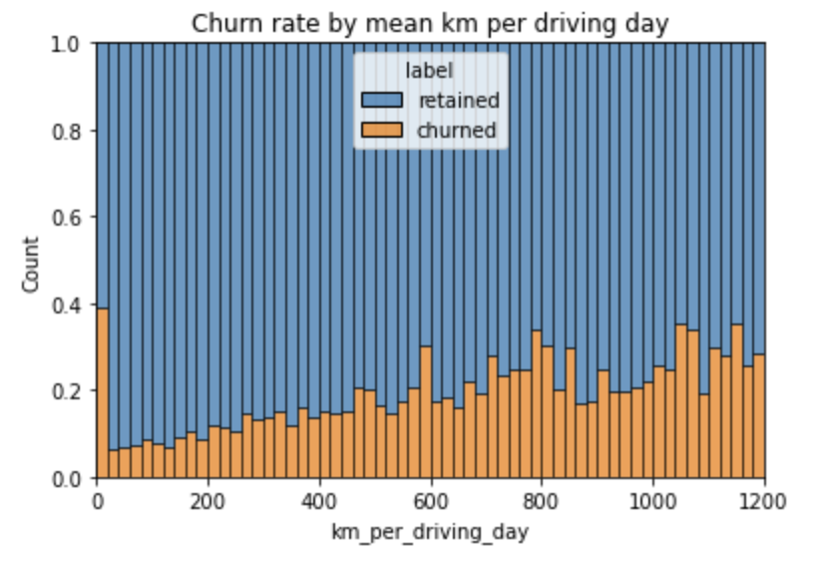
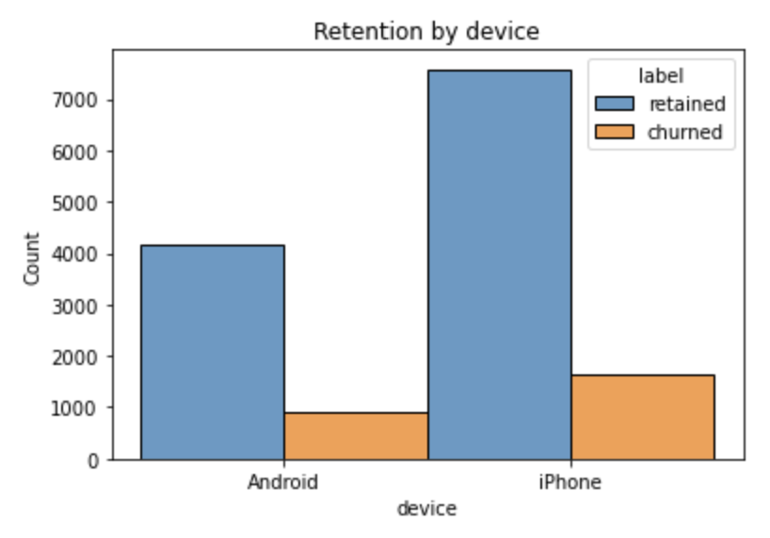
Churn User Project
Waze
Project Overview
The Waze team is working on increasing the overall growth by preventing monthly churn users on the app. With EDA, the team expects to target those users and make better decisions on how to engage with them that improves their retention rate in the future, guaranteeing more user interaction.
The more times the users use the app, the less likely they are to churn
Users who had longer driven kms were more likely to churn
The use of device had no relation to the churned users since it seemed to be uniform for both devices
Most of the data was right skewed which means users had lower values for those variables.
There were some outliers, specially in the driven kms column which was extremely high
Investigate the outliers in the data, values that could be problematic.
Continue exploration of the data
Perform deeper analysis of the data

